Slide 1
User Churn Project | Preliminary Data Summary
The Waze data team is working on a data analytics project focused on boosting overall growth by reducing monthly user churn in the Waze app. In this project, churn refers to the number of users who have either uninstalled the app or stopped using it.
This report offers a preliminary data summary, information on the project status and key insights of Milestone 2, which impact the future development of the overall project.
🎯 Target Goal: Investigate user data to learn important relationships between variables.
🎯 Methods:
Built a dataframe
Each row represents a single observation, and each column represents a single variable
Collected preliminary statistics
Analyzed user behavior
🎯 Impact: Team determined important relationships between variables that will guide further analysis of user data.
This dataset comprises of 82% retained users and 18% churned users.
The dataset contains 12 unique variables with types including objects, floats, and integers; the label column is missing 700 values with no indication that the omissions are non-random.
Churned users had, on average, ~3 more drives in the last month compared to retained users.
Retained users used the app on over twice as many days as churned users in the last month.
The median churned user drove ~200 more kilometers and 2.5 more hours during the last month than the median retained user.
Churned users tended to have more drives over fewer days, with their trips being longer in both distance and duration. This might hint at a specific user profile, which our team will need to investigate further!
The median user who churned drove 698 kilometers each day they drove last month, which is about 240% the per-drive-day distance of retained users.
Regardless of user churn, the users represented in this data drive a lot! It is probably safe to assume that this data does not represent typical drivers at large.
Team recommends gathering more data on the super-drivers. It’s possible that their high driving frequency is also why the Waze app doesn’t satisfy their specific set of needs, which may differ from those of a typical driver.
The immediate next step is to conduct thorough EDA and develop data visualizations to illustrate the narrative behind the data and guide future project decisions.

Slide 2
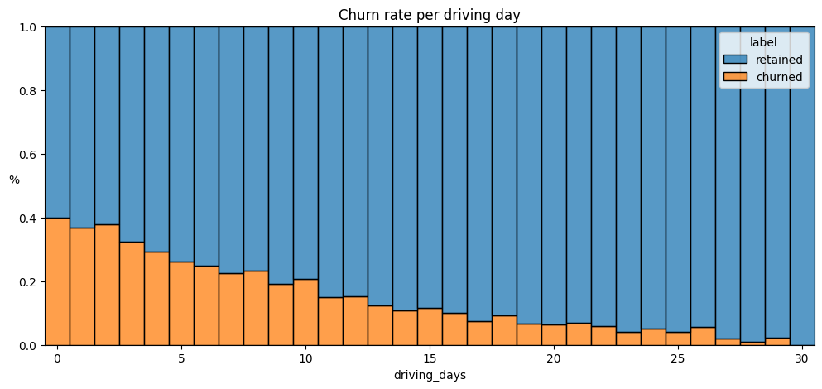
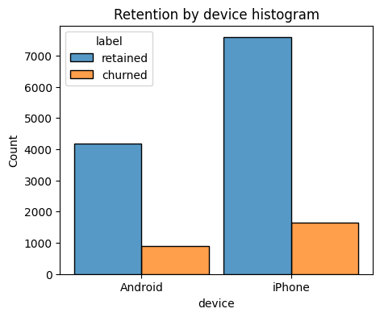
User Churn Project| Exploratory Data Analysis
Prepared for: Waze Leadership
Project overview
The Waze data team is working on data analytics project with a goal of increasing overall growth by preventing monthly user churn on the Waze app. EDA helps to discover patterns in the dataset and make a better decision about how to target users who likely to churn. This enables company to improve retention and overall customer satisfaction. This report provides details and key insights from Milestone 3, which impact the future development of the overall project.
The more frequently users engaged with the app, the less likely they were to churn. While 40% of users who did not use the app at all last month churned, none of the users who engaged with the app every day (30 days) churned.
There was a positive correlation between the distance driven per driving day and user churn. The greater the distance a user drove each day, the more likely they were to churn.
The number of driving days showed a negative correlation with churn; users who drove on more days during the last month were less likely to churn.
Several variables shows highly improbable, such as: driven_km_drives, activity_days and driving_days.
Users across all tenures , ranging from brand new to nearly 10 years, were relatively evenly represented in the data.
Almost all variables were either significantly right-skewed or uniformly distributed.
For the right-skewed distributions, most users had values on the lower end of the range for those variables.
For the uniformly distributed variables, users were generally equally likely to have values anywhere within the range.
Highest churn rate is observed for people who didn't use Waze much during the last month.
The proportion of churned users to retained users is consistent between device types.
Investigate the problematic variables, creating discrepancies between number of sessions, driving_days, and activity_days.
Explore user profiles with the greater Waze team; this may provide insights on the reason for the long-distance drivers’ churn rate.
Plan to run statistical analyses on the variables in the data to identify their impact on user churn.

Slide 3




User Churn Project| Two-sample Hypothesis Test Results
Subtitle: Waze Leadership Team
The Waze data team is currently developing a data analytics project aimed at increasing overall growth by preventing monthly user churn on the Waze app.
To improve retention, Waze wants to learn more about users’ behavior. This report offers information on the project status and results of Milestone 4, which impact the future development of the overall project.
🎯 Target Goal: Conduct a two-sample hypothesis test to determine whether there is a statistically significant difference between mean number of rides and device type – Android vs. iPhone.
🎯 Impact: Statistical tests allow the Waze data team to draw conclusions about the populations from which the data was collected and provide deeper insights into their user base.
Based on analysis, drivers who use an iPhone to access the application have a higher number of drives on average.
The t-test results concluded there is not a statistically significant difference in mean number of rides between iPhone users and Android users.
Average Number of Drives
66
68
Note: The mean number of drives shown here – 66 for Android and 68 for iPhone – have been rounded up.
After conducting this specific hypothesis test, the Waze data team recommends running additional t-tests on other variables to learn more about user behavior.
Additionally, since the user experience is the same, temporary changes in marketing or user interface may be impactful providing more data to investigate user churn behavior.

Slide 4
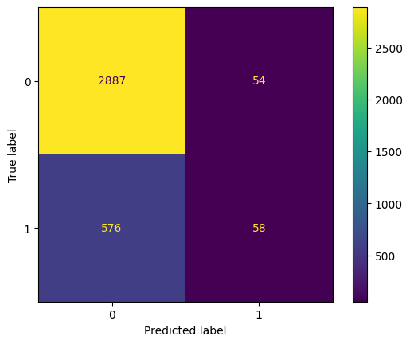
User Churn Project | Regression Modeling Results
Prepared for: Waze Leadership Team
The Waze data team is working on a data analytics project with the goal of boosting overall growth by reducing monthly user churn on the Waze app. In this context, churn refers to the number of users who either uninstall the Waze app or cease using it. Binomial logistic regression models are known for their flexibility and predictive capabilities, making them useful for guiding broader business decisions. This report outlines the findings and key insights from Milestone 5, which are critical for the future development of the project.
Milestone 5 - Regression Modeling
🎯 Target Goal: Apply user data to construct and analyze a binomial logistic regression model.
🎯 Methods:
Created features of interest to the stakeholders and business scenario
Assessed features for multicollinearity
Built the regression model
Evaluated model performance
🎯 Impact: With sufficient data, binomial logistic regression models can uncover significant relationships between variables and predict binary outcomes. These insights can guide decisions in areas like marketing and product development.
Note: 1-churned; 0-retained
The effectiveness of a binomial logistic regression model is judged by its accuracy, precision, and recall scores; recall is particularly critical in this model because it indicates the proportion of churned users correctly identified.
The model has mediocre precision, correctly identifying 53% of its positive predictions, but it suffers from very low recall, detecting only 9% of churned users. This indicates that the model frequently makes false negative predictions, missing many users who will churn.
Activity_days was by far the most important feature in the model. It had a negative correlation with user churn.
In earlier (EDA), it was observed that the churn rate increased with higher values in km_per_driving_day. However, in the model, the distance driven per day turned out to be the second least important variable.
Due to the model results, one suggestion would be using the key insights from this project milestone to guide further exploration.
This model should not be relied upon for making significant business decisions. However, it does provide valuable insights by highlighting the need for additional data (features) that correlate with user churn, as well as the potential necessity of better defining the user profile that Waze should target to achieve growth by reducing monthly churn on the app.

Slide 5

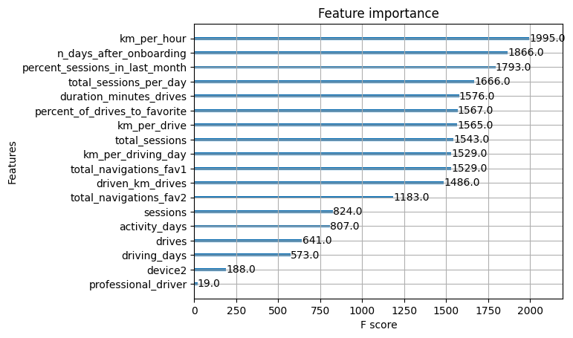
User Churn Project | ML Model Results
Prepared for: Waze Leadership Team
The Waze data team is currently developing a data analytics project aimed at increasing overall growth by preventing monthly user churn on the Waze app. For the purposes of this project, churn quantifies the number of users who have uninstalled the Waze app or stopped using the app. The ultimate goal for this project is to develop a machine learning (ML) model that predicts user churn. This report offers details and key insights from Milestone 6, which could impact the future development of the project, should further work be undertaken.
To obtain a model with the highest predictive power, the Waze data team developed two different models to cross-compare results: random forest and XGBoost.
To prepare for this work, the data was split into training, validation, and test sets. Splitting the data three ways means that there is less data available to train the model than splitting just two ways. However, performing model selection on a separate validation set enables testing of the champion model by itself on the test set, which gives a better estimate of future performance than splitting the data two ways and selecting a champion model by performance on the test data.
The ML models developed for Milestone 6 demonstrate a critical need for additional data in order to more accurately predict user churn.
This modeling effort confirms that the current data is insufficient to consistently predict churn. It would be helpful to have drive-level information for each user (such as drive times, geographic locations, etc.). It would probably also be helpful to have more granular data to know how users interact with the app. For example, how often do they report or confirm road hazard alerts? Finally, it could be helpful to know the monthly count of unique starting and ending locations each driver inputs.
Since engineered features are a proven valuable tool for improving the performance of ML models, the Waze team recommends a second iteration of the User Churn Project.
Engineered features accounted for six of the top 10 features: km_per_hour, percent_sessions_in_last_month, total_sessions_per_day, percent_of_drives_to_favorite, km_per_drive, km_per_driving_day.
The XGBoost model fit the data better than the random forest model. Additionally, it’s important to call out that the recall score (17%) is nearly double the score from the previous logistic regression model built in Milestone 5, while still maintaining a similar accuracy and precision score.
The ensembles of tree-based models in this project milestone are more valuable than a singular logistic regression model because they achieve higher scores across all evaluation metrics and require less preprocessing of the data. However, it is more difficult to understand how they make their predictions.

